Slide 1

G2M Case Study
Virtual Internship
Name : Mohammad Odeh Location: United Arab Emirates Team: Data and Analytics Date: 11-March-2021

Slide 2
Background –G2M(cab industry) case study
XYZ is a private equity firm in US. Due to remarkable growth in the Cab Industry in last few years and multiple key players in the market, it is planning for an investment in Cab industry.
Objective : Provide actionable insights to help XYZ firm in identifying the right company for making investment.
EDA consisted of:
Understanding the Data individually ( each data set )
Merging the data sets into a master data set
Creating new features
Finding the most profitable Cab company
Providing recommendation for investment based on the findings

Slide 3
Data Exploration
16 Features( including 4 derived features)
Timeframe of the data: 2016-01-1 to 2018-12-31
Total data points : 359392
Assumptions:
No outliers in the datasets; all data is treated normally
Users column from city dataset is treated as number of cab users in the city
Users is divided into 3 age groups ( 18-35, 36-60-60+ )

Slide 4
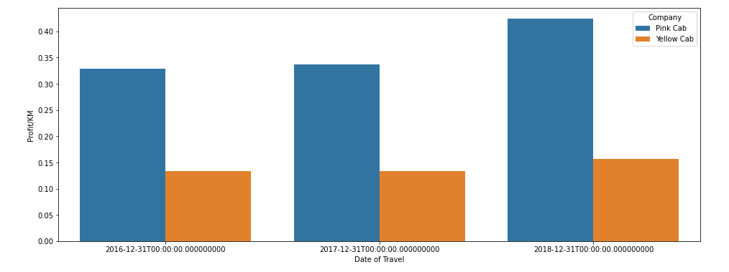
Profit Analysis
Pink Cab:
Profit: 5307328.32100
Rides: 84711
Profit/Ride: 62.65217
Profit/KM: 2.77715
Yellow Cab:
Profit: 44020373.17080
Rides: 274681
Profit/Ride: 160.25999
Profit/KM: 7.10073

Slide 5
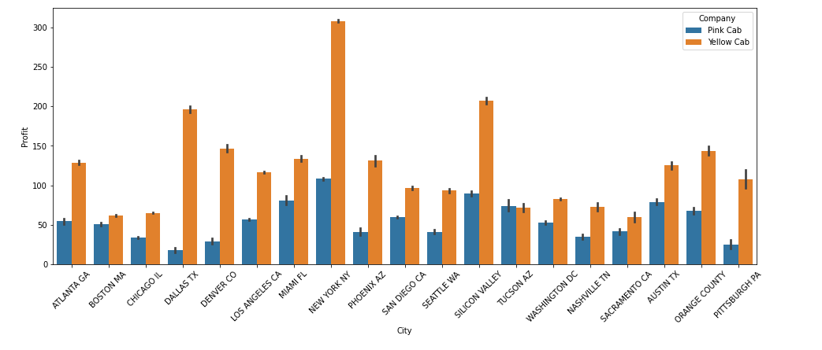
Profit Analysis

Slide 6
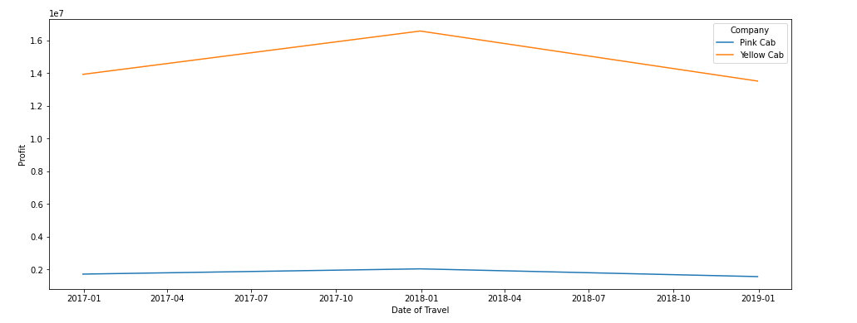
Yearly Profit Analysis

Slide 7
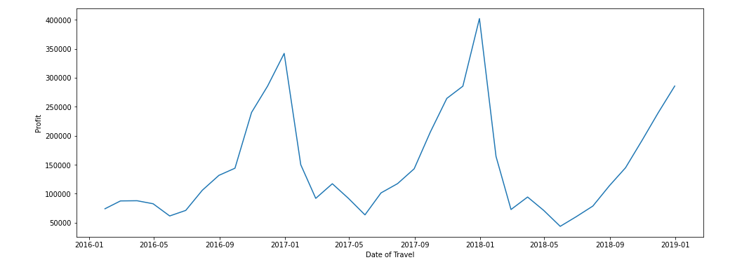
Monthly Profit Analysis
Yellow cab

Slide 8
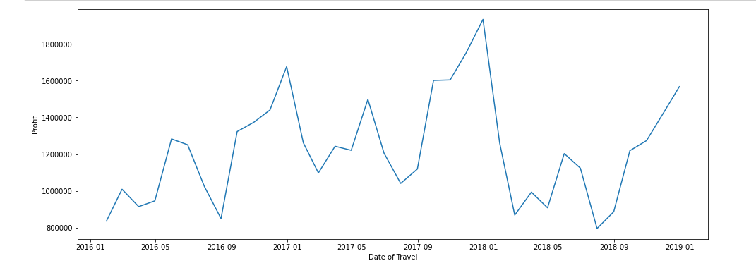
Monthly Profit Analysis
Pink cab

Slide 9
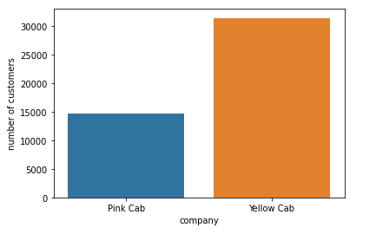
Number of Customers Per Company
Yellow Cab has more than more than double the number of customers

Slide 10
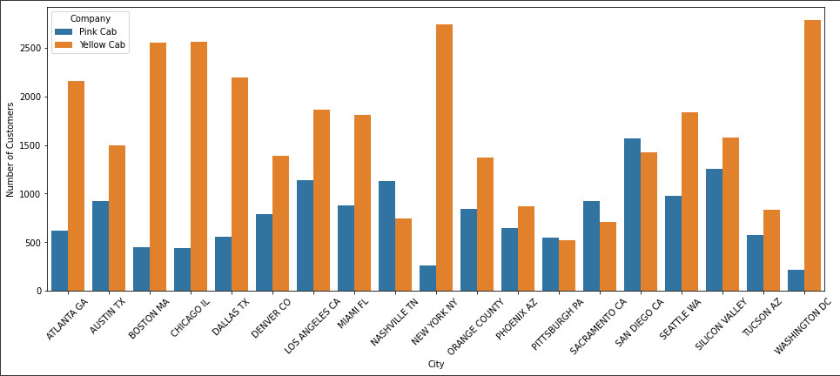
Users Covered By Company Per City

Slide 11
Recommendations
Based on the following points:
Yellow cab has a higher customer base in 15 cities compared to 4 cities for Pink cab .
Yellow cab is doing far better than Pink cab in customer retention; meaning that customers return and use the same company more often
profit per KM for Yellow cab is about three times the profit per KM of the Pink cab.
Yellow cab is performing better in offering services to all income class groups (low, medium and high)
Yellow cab has more than three times the number of rides compared to pink cab, which indicate more coverage
Based on the evaluation of both companies and found Yellow cab better than Pink cab for investment and we recommended it

Slide 12
Thank You

